Slide 1


MANAGING HUMAN CAPITAL
How do we better outcomes on education and health for our future generations?
Sayantan Pal B19ME077
Ved Thakur B19ME090

Slide 2
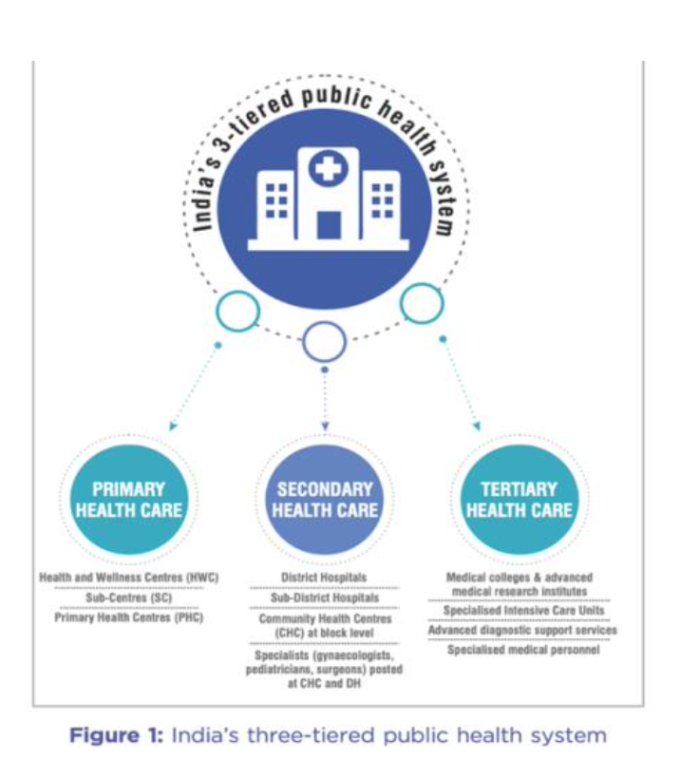
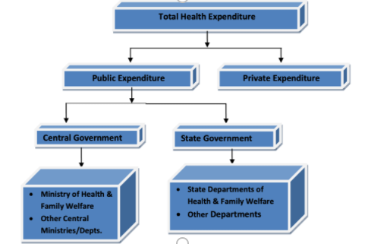


Indian Health Care System
Public healthcare is free for every Indian resident. Middle- and upper-class individuals living in India tend to use public healthcare less than those with a lower standard of living. The public health care system was originally developed in order to provide a means to healthcare access regardless of socioeconomic status or caste
Levels of Healthcare system
Primary Healthcare
Sub Centers and Primary Health Centers (PHCs)
Secondary Healthcare
Community Health Centers (CHCs) and smaller Sub-District hospitals.
Tertiary Healthcare
Medical Colleges and District/General Hospitals.

Slide 3

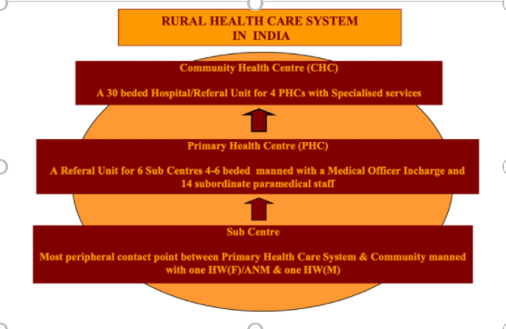

Rural Health Care System
Subcenter
Primary Health Centers
A Sub Centre is designed to serve extremely rural areas with the expenses fully covered by the national government. Mandates require health staff to be at least two workers (male and female) to serve a population of 3000-5000 people Sub Centres also work to educate rural people about healthy habits for a more long-term impact.
Primary Health Centers exist in more developed rural areas of 30,000 or more and serve as larger health clinics staffed with doctors and paramedics. Patients can be referred from local sub centers to PHCs for more complex cases.
The state governments fund PHCs.
PHCs also function to improve health education with a larger emphasis on preventative measures.
Communal Health Centres
A Community Health Centre is also funded by state governments and accepts patients referred from Primary Health Centers. It serves 120,000 people in urban areas or 80,000 people in remote areas. Patients from these agencies can be transferred to general hospitals for further treatments.

Slide 4

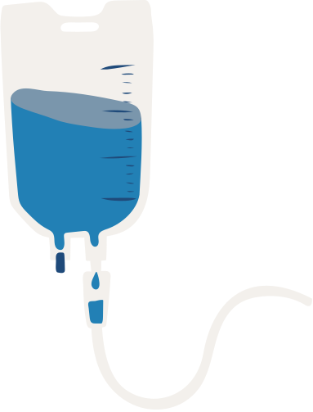
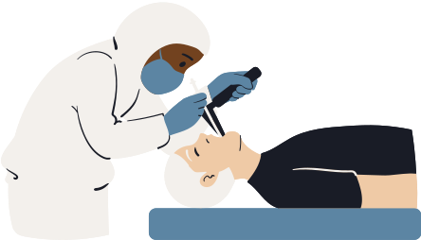
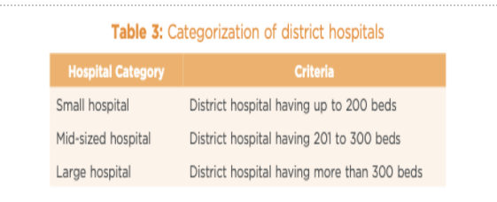
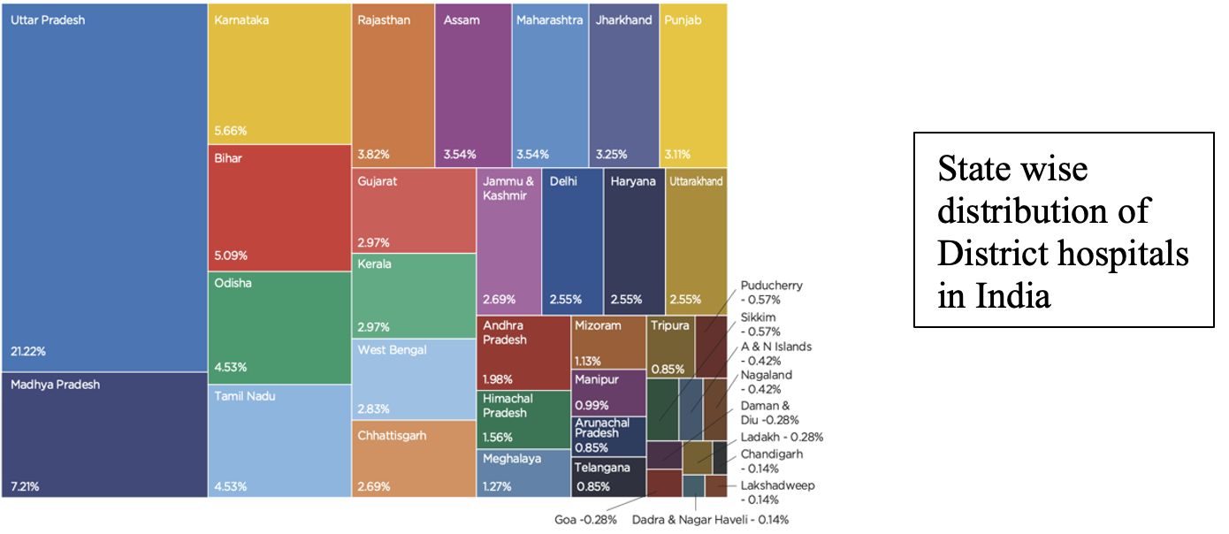

District Hospitals
A total of 810 district hospitals across India provide critical services to the population. It is expected that at least one hospital is in each district of India. These are funded for by the Public.
First Referral Unit (FRU)
Medical Colleges and Research Institutions
An existing facility (District Hospital, Sub-divisional Hospital, Community Health Centre etc.) can be declared a fully operational First Referral Unit (FRU) only if it is equipped to provide round-the-clock services for emergency obstetric and Newborn Care, in addition to all emergencies that any hospital is required to provide.
Medical colleges in India are both government owned and private owned depending on the nature of institution.
In India there are a total of 543 medical colleges. Also, there are 64 Standalone PG institutes in India.

Slide 5
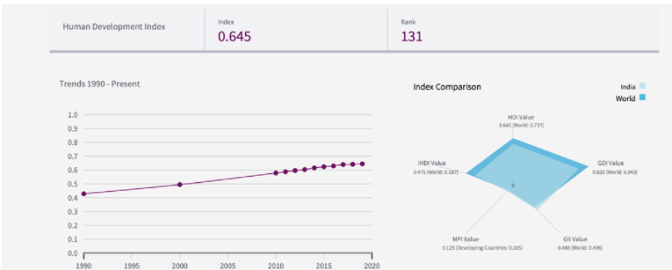


Outcomes And Performance On Outcomes Of Health Sector
On the Human development index, India ranks at 131 with a H-index of 0.645 .India’s 2019 HDI of 0.645 is above the average of 0.631 for countries in the medium human development group and above the average of 0.641 for countries in South Asia
Life Expectancy
Tuberculosis Incidence
(per 100000 people)
India, a long distance has been walked with regards to increasing life expectancy and this factor has increased from an average life expectancy of 57.9 in 1990 to a value of 69.7 in 2019
The world average for this value lies at 72.8 years.
The number of tuberculosis incidences in India has nearly halved and now the value is far above the world average,

Slide 6


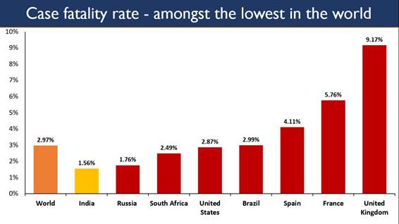
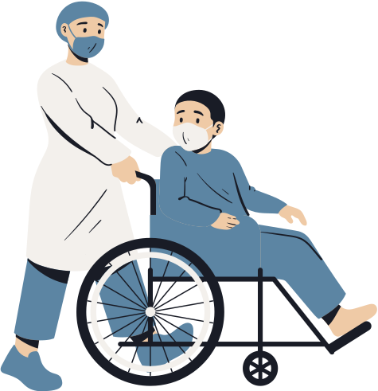
Mortality Rate, Under-five (per 1,000 live births)
Mortality rate in India, has reduced from 126.2 in 2000 to 26.6 in 2018 .This is a commendable achievement .India now has a mortality rate that is close to the world average
Age-standardized mortality rate attributed to noncommunicable diseases
Age standardized mortality rate for both males and females in India have just like mortality rate shown great reduction and although the value stand over the world average right now. .
Infants lacking immunization
measles (% of 1 year-olds)
The percentage of surviving infants who have not received first dose of measles has been reduced to only 5% as compared to a value of 44 percent in 1990.

Slide 7
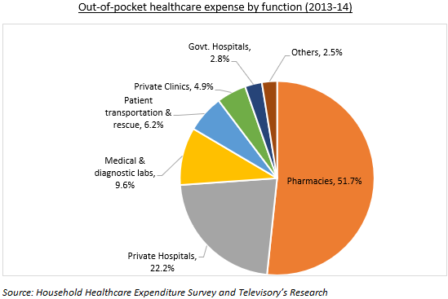
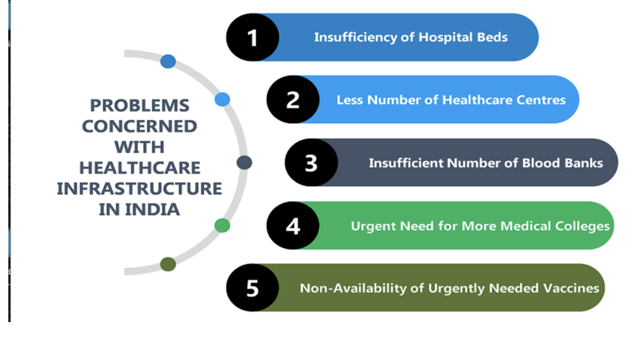

Issues Inhibiting Effective Functioning of Healthcare Systems
Absence of Human Capital
The doctor-patient ratio is extremely low at 0.74 per 1000 individuals,
The nurse-to-doctor ratio is at 1.7:1
The allied health workers to doctors ratio is 1:1.1
Lack of Infrastructure
The government Rural Health Survey only 55.6% of CHCs have functional X-ray machine while only 18% of specialists required (surgeon, physician, gynecologist and pediatrician) are in place. Alongside this, only 8% subcenter's, 12% PHCs and only a mere percent which is only 13% CHCs met Indian Public Health Standards.
High Cost of healthcare
Public financing of health is among the lowest in the world at just over 1% of GDP, and out-of-pocket (OOP) spending is very high at around 3% of GDP. Share of OOP in total spending in India is one among the highest in the world

Slide 8



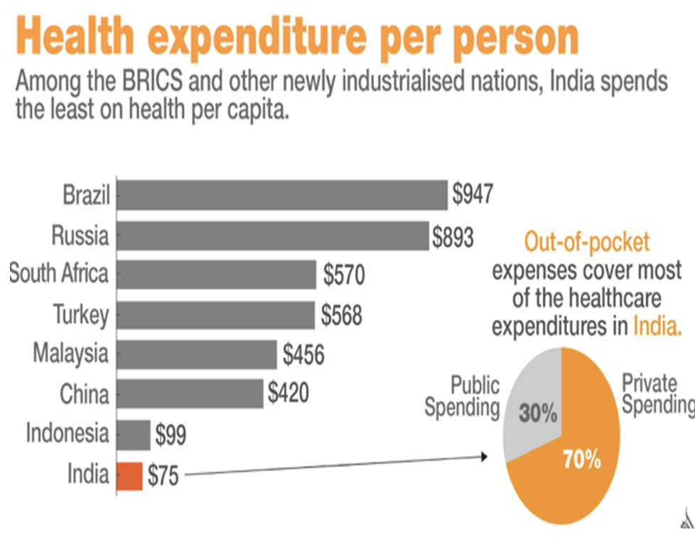
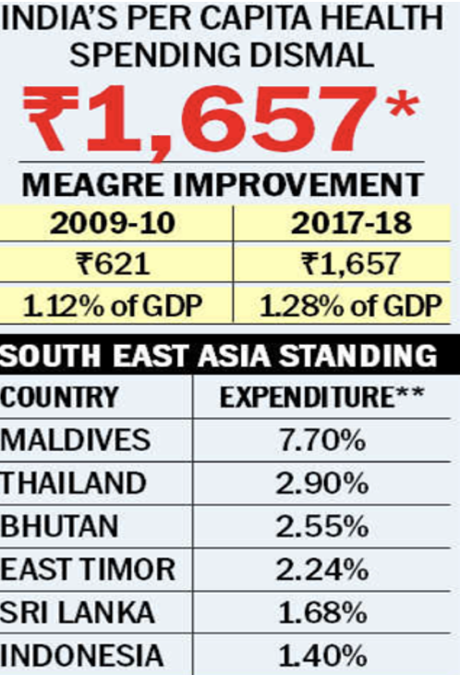
Poor Health Expenditure Per Capita
India spends only Rs. 1657 which Is only 1.28% of GDP which is low as compared to 7.7% of Maldives, and even 1.4% of Indonesia .At present ,In India on healthcare for an individual, 30% constitutes government funding.
Insufficient Medical Research and Lack of Funding
During 2011-12 the total funding available for funding in India was $1.42 billion, which was about 0.09% of the GDP at the time, only 0.02% from the public peripherals.
Unmanageable Patient-load
India has a dearth of beds, doctors, nurses, medicines etc. In short, India lacks in medical facilities. These kind of situations made it difficult for one to manage load whilst doing work efficiently.
Neglect of Rural Population
According to health information only 31.5% of hospitals and 16% hospital beds are situated in rural areas where 75% of total population resides. We can therefore say that, Health care infrastructure is heavily skewed in favor of urban areas.

Slide 9

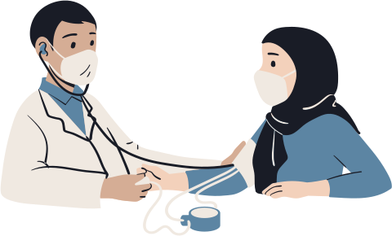
Proposed Solutions
Telemedicine, Tele-conferencing and Mobile Medical Units
The telemedicine units have a well-equipped infrastructure and work on a hub-and-spoke model.
Doctors based in a central hub consult patients virtually, whilst a trained nurse facilitates in remote locations where patients reside.
The mobile medical units on the other hand, have trained medical officers and nurses..
Ambience Management And Structural Reforms to Existing PHCs and Hospitals
Mohalla clinics can be a good alternative while in villages SCs and PHCs should be strengthened.
This can be achieved with minimum cost and maximum efficiency.
Online monitoring of all the facilities of a health center can be done.
Building Capacity of Frontline Workers
To meet shortage of trained staff preference should be given to local people.
To solve problem of abstaining, local people should be trained and posted in SCs, PHCs and CHCs of difficult/ tribal and hilly areas.
Skills of good performing ASHA, ANM workers and nurses should be upgraded a

Slide 10




Blending With The Community To Find Customized Solutions
Blending with the community to find customized solutions is imperative.
The help of community people should be sought for providing health care to all because no program me can be successful without active involvement of community
Increasing technology adoption in improving healthcare
The process of drug creation can be automated by AI programs. Thus lowering the costs of developing pharmaceuticals
AI-based apps can be used to provide medical consultation based on personal medical history
IoT can also be used to derive valuable insights from data derived from foetal monitors, electrocardiograms, etc.
Strengthening systems through research, data, partnerships and policy advocacy
With the help of partnerships, a new world of collaboration can be started starting from sharing of doctors to equipment’s and facilities.
New regimes of research should be started in different segments of the Indian healthcare system.
More focus should be put on the rural side of the system.

Slide 11

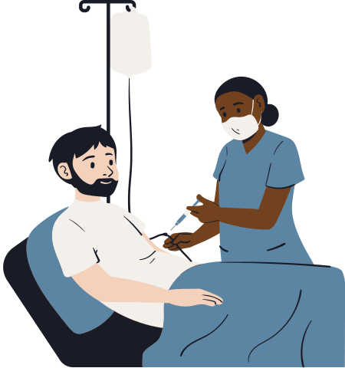
Reasons for the Solutions
Telemedicine, Tele-Conferencing And
Mobile Medical Units
Reason
There has been a Growth of internet use in India and the internet penetration has been noticeable
Although doctors may not be accessible, there is a great possibility that internet would be accessible to the patient .
Mobile Medical Units on the other hand can be useful for cases when the patient is serious and can't visit the doctor
Evidence
Tata Trusts deployed a model in Mathura and Varanasi districts .Under this, Thirty-five telemedicine unit spokes connected to two doctors’ hubs and were supported by six mobile medical units. This translates into 500,000 medical consultations and screening, diagnosis, and on-going treatment of more than 100,000 individuals for NCDs such as diabetes, hypertension, and cancer. Besides, these hub-and-spoke models also provide necessary care for minor ailments that range from fevers to musculoskeletal disorders, etc.

Slide 12
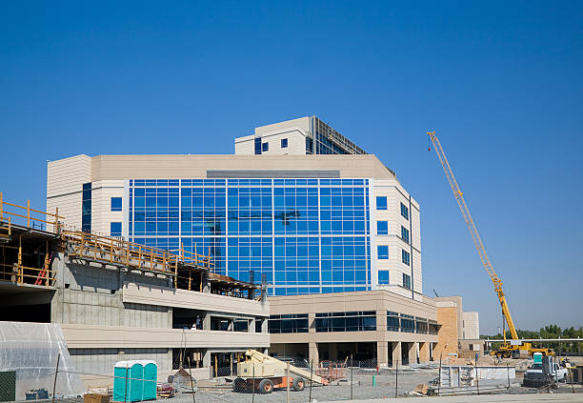


Ambience Management And Structural
Reforms To Existing PHCs And Hospital
Reasons
By upgradation of the infrastructure, we can ensure that the extra load from higher segments the healthcare system is removed whilst making sure that patients don’t have to travel to long distance in order to get treatment.
Evidence
In Delhi, Mohalla clinics have been opened and they have been working in a manner that resonates with the objectives. There are around 500 Mohalla clinics currently functional in Delhi
Tata Trusts, have employed a PPP with Nagpur MC helped modernize 25 urban PHCs. All this has resulted in increased utilisation of the same government facilities – there was a 250% increase in utilisation.
At the 129-year-old Regional Mental Hospital in Nagpur, The Tata Trusts have been working to address the critical needs of patients by building acute wards, washrooms, etc.

Slide 13


Building Capacity Of Frontline Workers and
Putting More Focus On Creation Of Local Workers
Reasons
By upgrading skills of good performing ASHA, ANM workers and posting them in their own rural and remote areas. We would encourage other to work harder and perform better to get posted in their own rural and remote areas of PHCs and CHCs.
Evidence
The Tata Trusts are helping mentor and build the capacity of frontline workers in 29 states and 9 union territories. More than 60,000 health workers across the country have been trained in NCD detection and management through the Tata Trusts Pan India NCD programme.
In an experimental intervention in 2013 in West Bengal, the Liver Foundation in collaboration with researchers offered more than seventy sessions of training to informal-sector providers over a period of nine months.

Slide 14


Blending With The Community To Find Customized Solutions
Reasons
By reaching out to people in community, there can be better transmission of intended information as well as mimicking of practices(such as wearing masks) can be achieved in a better manner.
Evidence
An example is the creation of society based temporary beds (as was in the case of COVID-19 in Delhi).
Kerala is a good example that took help of educated youth and Panchayati Raj Institutions for implementing her health programmes.

Slide 15


Increasing Technology Adoption In Improving Healthcare
Reasons
By the adoption of newer technologies managing, operating as well as attending patients would be made easier. Patients will be able to get in depth analysis.
Evidence
ASMAN is an application that incorporates clinical decision support systems on a platform that utilises online and offline medical oversights for timely interventions in intrapartum and neonatal care.
Over 1.1 million electronic health records (EHR) were created in Telangana, pushing the state to aggressively adopt telehealth to network over 60 HUB hospitals and 3000 PHCs.

Slide 16


Strengthening Systems Through Research, Data, Partnerships And Policy Advocacy
Reasons
The investment in medical research sector in India is poor. Therefore, newer investments are needed to bolster India’s research and take it on a path of self-reliance.
Evidence
The Tata Trusts has incubated the Health Systems Transformation Platform (HSTP), to be an enabler of state-level capacity to evaluate, redesign and strengthen healthcare systems.
The not-for-profit HSTP partners with the prestigious Harvard TH Chan School of Public Health at Harvard University, USA.

Slide 17
Education
Sector

Slide 18
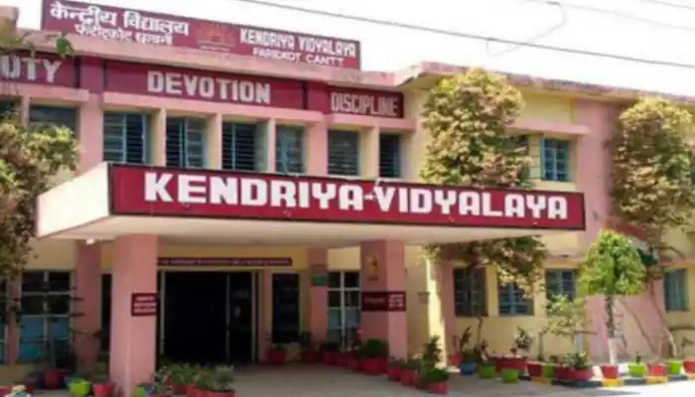
Types of Schools
Public/Government schools:
These schools are fully funded by the government alongside a small amount of donation from NGO’s and other people.
Private schools:
Private aided schools
Private unaided schools
International schools:
Government-funded international schools
Partially funded international schools
Privately funded international schools

Slide 19

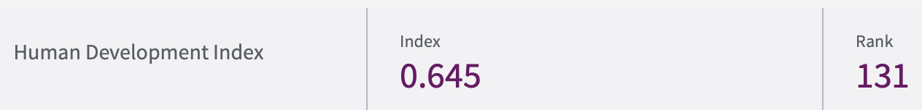
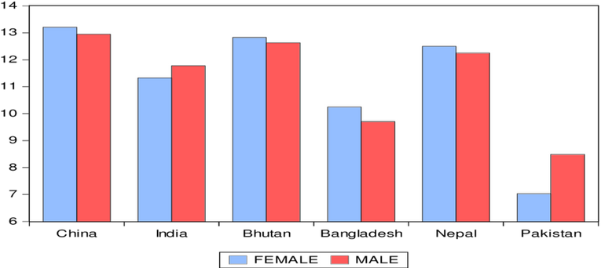
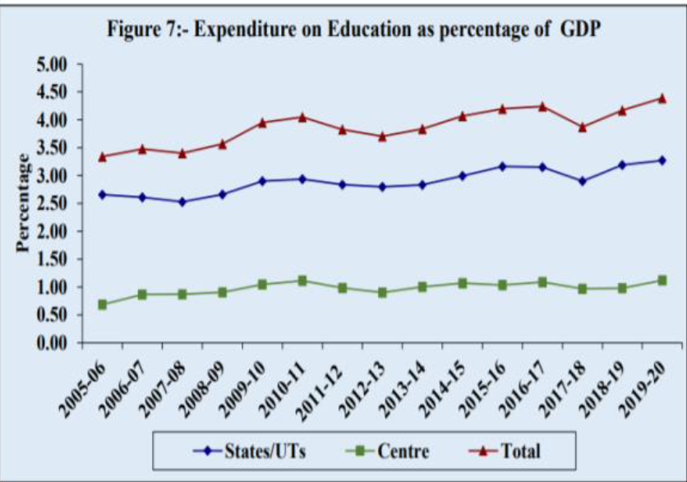
Outcomes And Performance On Outcomes Of Education Sector
India’s HDI value and rank
India’s HDI value for 2019 is 0.645 which put the country in the medium human development category positioning it at 131 out of 189 countries
Expected years of schooling (years)
We see that India has 12.2 years of Expected years of schooling and this value has risen from a low of 7.8 in 1990 . This value of 12.2 pits near but short of the world average of 12.7 Expected years of schooling.
Government expenditure on education
We see that the government expenditure as a percentage of GDP has been fluctuating since that of the early 2000’s but as Indian GDP has multiplied manifold during this time, we can safely say that the public expenditure of education has increased

Slide 20
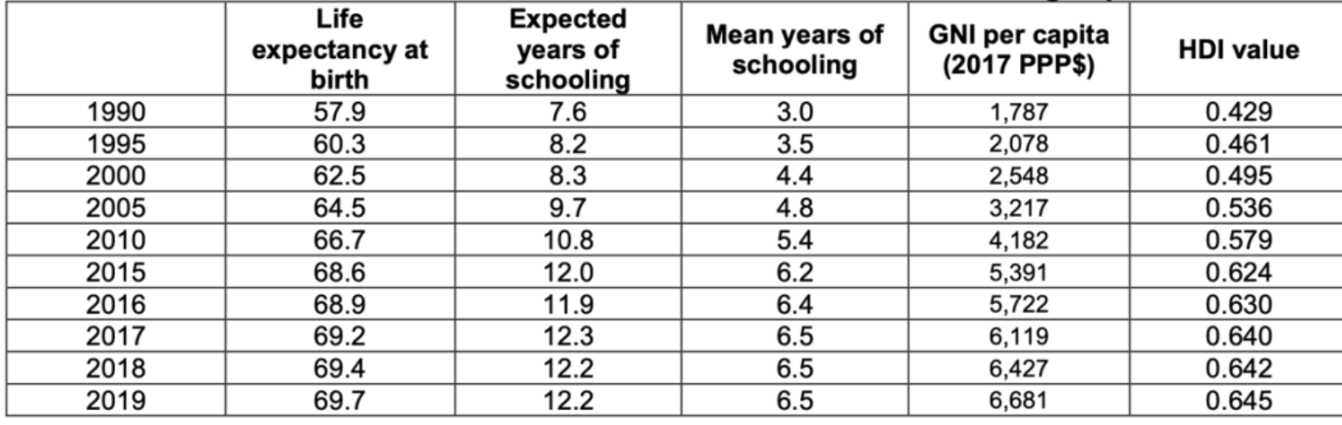
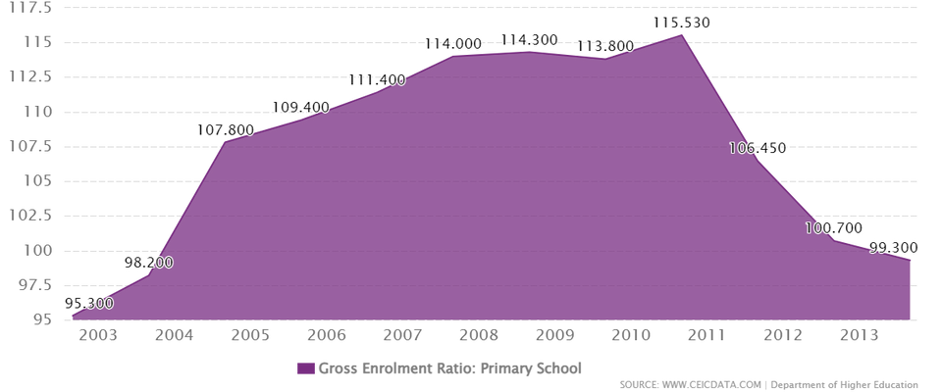
Primary school teachers trained to teach
We see that India has 70% Primary school teachers trained to teach and this value is pitted against a world average of 81% and a South Asia average of 71%
Gross enrolment ratio, pre-primary(%)
We see that India has a significant increase in pre-primary gross enrolment ratio from 1990 to 2014 (from 3 to 14) and this factor on a world average has a value of 52
Gross enrolment ratio, primary(%)
We see that India has a significant increase in primary gross enrolment ratio from 1995 to 2019 (from 91 to 113 and this factor on a world average has a value of 104.
Gross enrolment ratio, secondary(%)
We see that India has a significant increase in primary gross enrolment ratio from 1995 to 2019 (from 45 to 75 and this factor on a world average has a value of 78

Slide 21
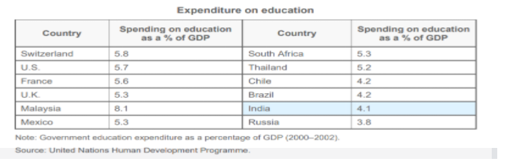

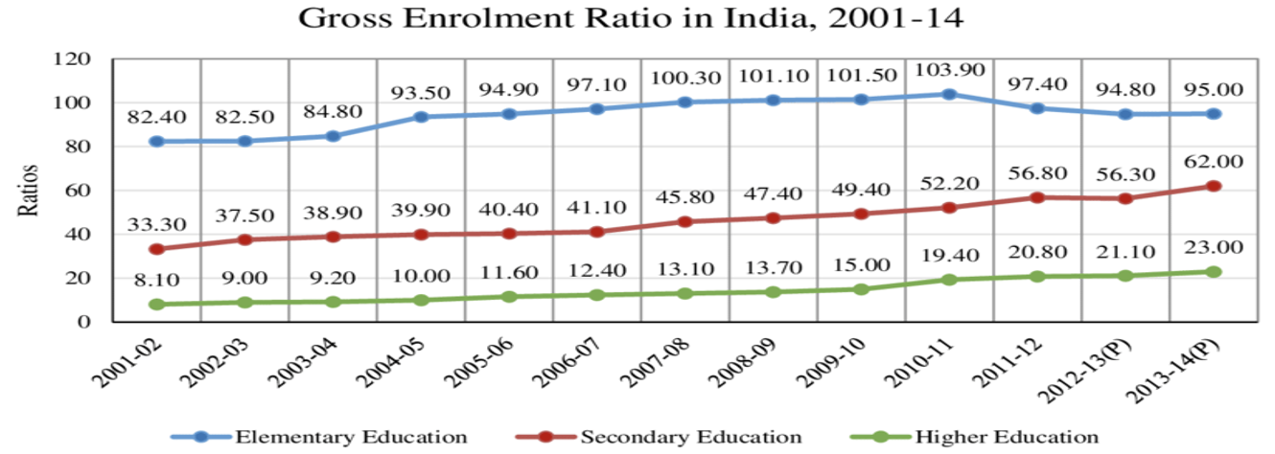
ISSUES
Lower Expenditure on education as compared to other countries.
When we look at education spending as a percentage of GDP, India falls below several developed and developing countries. We understand that there is a funding shortage, which can perhaps be fulfilled by investments from private sector. Higher Public expenditure would mean a shift of students from public to private, leaving only poor households tied to the public system.
Low Gross Enrolment
There is severe worry about these educated people's employability. In 2010, India's gross enrolment ratio (GER) for higher education was 13%. We must also acknowledge that our enrolment rate is far lower than that of numerous other nations. China has a GER of 23%, Brazil has a GER of 34%, the United Kingdom has 57% and the US has 83%

Slide 22
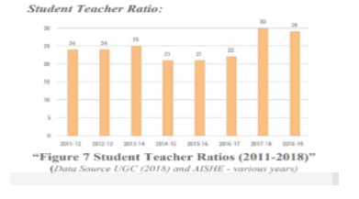

Lack of Facilities/ Low Student-Teacher Ratio
This ratio is 11.4 in industrialized nations, it is as high as 22.0 in India. According to the 2016 Annual Survey of Education Report, 3.5 percent of Indian schools had no toilet facilities, while just 68.7% had usable toilet facilities.
Lack of Good Quality of teaching
Numerous of our experts are unemployed, even though many chances exist in the globalized world. One of the key issues is a lack of quality education. Only two of India's leading business schools appeared in the top fifteen of the Financial Times' worldwide ranking
Preponderance of Traditional Teaching Methods and lack of Project Based Learning
In the school system, there is a need for technology and the internet, particularly in rural regions, which is not being met. Most colleges continue to use outdated and out-of-date curricula as the quality and skill of education is changing every day due to globalization.

Slide 23

Solutions
1
By Establishing a Connection between Industry and Academics and Redesigning of Courses Taught by Educational Institutions.
By Establishing a link between industry and academia (which is critical), individuals should acquire skills and knowledge that can ensure employability and make effective use of information, skills etc. that they gained.
Programs and courses in educational institutions should be prepare/designed in a way that students can choose multifarious roles and companies.
2
By Giving Importance to Technology in Education/ High Tech Libraries
Advances in communication, information, and technology will lead to the creation of new, innovative, and cost-effective means of providing higher education to individuals.
It is, therefore, critical to guarantee that libraries in nursery schools, other schools, colleges, and universities are well-developed, well-organized, and include all the necessary resources relevant to all the disciplines that are important to the students. It is also imperative to make sure that computers and the internet are also only available at higher educational institutions, colleges, and universities, where students can utilise them.
This can be made sure by creation of new libraries, computer centres and public WI-FI hotspots so that all can access internet with ease.

Slide 24
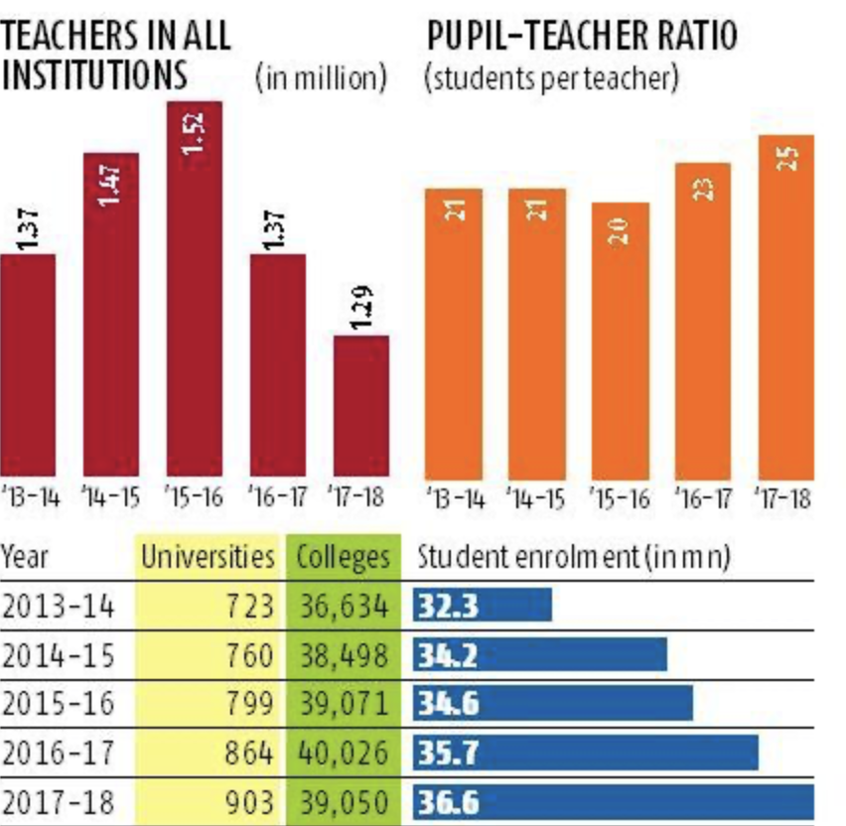
Student-Centered Education and Dynamic Methods
Lecture-based teaching approaches will have to be replaced by methods that emphasize self-study, personal interaction between professors and students, alongside having dynamic seminars and workshops.
The student ratio must be reduced. (Currently, the ratio is around 25, it should be reduced to 15 so that a student can gain maximum attention from an instructor).
Give more significance to primary and secondary education
Primary education is the foundation of a country’s educational system. All future studies will be jeopardised if primary and secondary school instructors are inexperienced, unqualified, and underpaid.
Instructors should be given incentives so that the quality of instruction does not suffer.
Enabling World Class Education
Many national institutions, such as those in the United States, the UK, and Australia, enable overseas students to study higher education in their nations as well as via correspondence courses. Similarly, by leveraging the globalisation process, India's world-class universities may offer courses to international students
consistent worldwide curriculum should be implemented

Slide 25
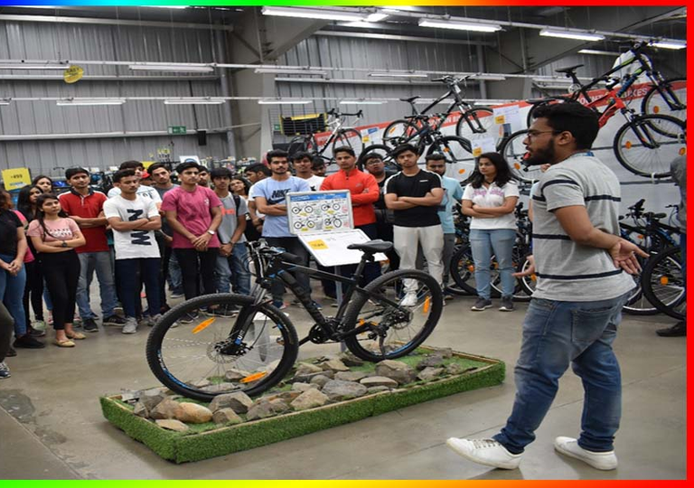
Reason Out The Solutions And Evidence
By Establishing a Connection between Industry and Academics and Redesigning of Courses Taught by Educational institutions.
Reason
Courses in Indian Education system lack Industry interaction. They are more theory based than practical based/project based. Therefore, a shift in the structure of courses to more project-based courses would ready students for the future.
Also, it would enable them to gain multiple skills related to different sets of industries as.
Evidence
Almost 90% of life-science enterprises in the United States have some sort of academic link.
Moreover, half of life-science corporations (59 percent) contributed to university research, and 38% supported training by providing grants, fellowships, or scholarships to students and fellows. This enabled both research funding and promoted training all in one go

Slide 26
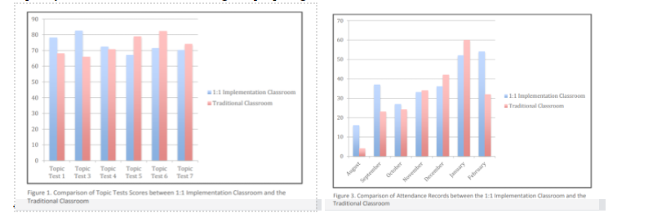
By Giving Importance To Technology In Education
Reason
Student motivation is another key aspect of 1:1 technology. In the classroom, the instructor must be aware of how and why pupils are driven to study. When introducing 1:1 technology into the classroom, teachers must first assess their student population to determine who they are working with.Technology, whether in the form of laptops or other devices, should be viewed as a supplement to rather than a replacement for best practises in the classroom. Technology should be adopted with the use of tech personalised to the required level. This makes this factor that is sure to succeed
Evidence
A set of 7 tests (Topic Tests) was given in two different types of classes, one was to an Implementation Classroom(tech-enabled) and the other a Traditional Classroom .In terms of the outcomes, the Topic 3 Test was the first test given in both classrooms at the start of the school year. On this Topic Test, the 1:1 Implementation Classroom scored much higher than the Traditional Classroom, The newness of the computers, the joy of the children participating, and the capacity to better discriminate using a laptop might all have contributed to these results

Slide 27
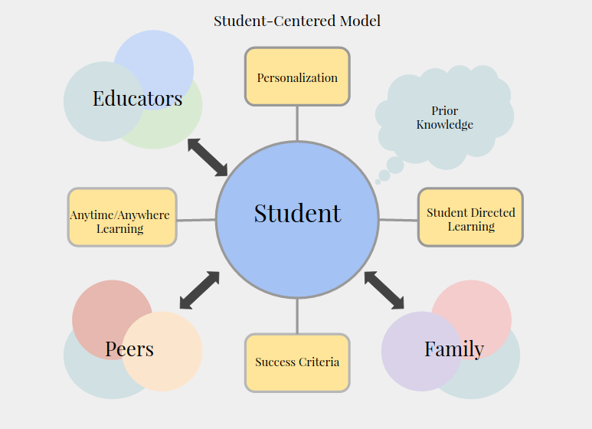
Student Centered Education and Dynamic Model
Reason
It is a fact that higher education methods must also meet the requirements of learning to learn, learning to do, learning to be, and learning to become.
To ensure this, Teachers will need to adopt new attitudes and abilities as a result of student-centred education and the use of dynamic educational approaches
Lecture-based teaching approaches will have to be replaced by methods that emphasise self-study, personal interaction between professors and students, alongside having dynamic seminars and workshops.
The emphasis therefore needs to be shifted from Teacher centred to Student centred.
Evidence
Since 2001, the 2nd year Macroeconomics Unit Panel has seen an increasing number of students who are having difficulty completing a unit. After Redesign lectures, tutorials and assessments in the Macroeconomics unit (HBE220N) in a manner which would facilitate student-centred teaching and learning and implementing a shift from a teacher-centred to a student-centred approach. The action learning paradigm provided a significant role for reflection on teaching practise. Since the introduction, the percentage of students earning credits, distinctions, and high distinctions had grown.

Slide 28
Thank you!
Have a great
day ahead.

